Slide 1
BASIC COURSE IN R FOR HISTORICAL DEMOGRAPHY
Exercises: Introduction to R
Lecturer: Marco Novelli

Slide 2

Task 1
Create a vector x that contains the values (1 2 3 4) and a vector y that contains the values (-1 1). Concatenate x and y and store the result as z. Print it.
Create a vector s as the sum of x and y. Print s. For every entry in s, explain how R has computed it.
What happens if you compute the sum of x and z? Explain why.

Slide 3
Task 2
Create a vector u which contains all integers from 1 to 100
Create a vector x which contains the elements of u which are not a multiple of 3.
Create a vector y which contains the elements of u which are neither divisible by 2, nor by 3, neither by 5.
Create a vector z replacing all elements from u that are less than 55 by the number 0.

Slide 4
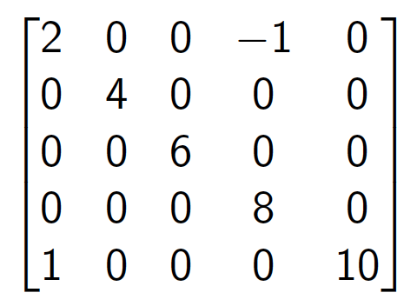
Task 3
Create the following matrix as efficiently as possible and store the matrix as P.

Slide 5
Task 4
Using the matrix P from the previous task:
Print the first row and the second column of P.
Print the submatrix that consists of the last three rows and first two columns of P.
Replace the fourth row of P by (1, 2, 3, 4, 5).
Replace all nonzero entries of the matrix P by 1.

Slide 6
Task 5
With the dataset swiss, create a data frame with only the rows 1, 2, 3, 10, 11, 12 and 13, and only the variables Examination, Education and Infant.Mortality and call it t11.
The infant mortality of Sarine is wrong, it should be an NA, change it.
Create a row that will be the total sum of the column, name it Total.
Create a new variable that will be the proportion of Examination (Examination / Total)

